Slide 1
Faculty Senate Enrollment Management Update
March 5, 2019

Slide 2
AACRAO FEEDBACK AND RECOMMENDATIONS

Slide 3
AACRAO FEEDBACK
Align institutional strategic plan with broad enrollment targets and desired mix of students.

Slide 4
AACRAO FEEDBACK
Achieve an institutional culture of partnership and collaboration, including leadership, participation and buy-in, and elimination of silos.
OBSERVATION: There appears to be difficulty working between and among departments, colleges, and schools at UMKC, perhaps resulting in lack of trust in business services, processes, and future direction of the enrollment management enterprise.
RECOMMENDATION: Rebuilding trust of enrollment management and the Office of Admissions is necessary. Collaboration and cooperation across campus must improve.
RECOMMENDATION: Engage in change management activities.

Slide 5
AACRAO FEEDBACK
Developing an enrollment infrastructure sufficient to achieve enrollment targets.
OBSERVATION: The planned reorganization of the Office of Admissions should further enhance enrollment management effectiveness.
RECOMMENDATION: Continue to reorganize the admissions function of the institution, collaborating with campus partners and communicating in a transparent way about next steps. Shared services should be a model investigated to eliminate silos.
RECOMMENDATION: Within SEM Organizational Framework, develop Recruitment Council. This Council should focus on 3-4 strategic goals for new student recruitment, review, and approve sub-committee action plans for recommendation to the SEM Steering Committee.

Slide 6
AACRAO FEEDBACK
Enhancing the admissions funnel system that effectively and seamlessly moves a student from prospective status to confirmed enrollment.
OBSERVATION: UMKC has not conducted a meaningful market analysis, which is reflected in how it conducts its marketing and student recruitment efforts. These efforts have not been strategic or systematic.
OBSERVATION: Given the range of technologies available at UMKC, there appears to be a need to explore how to better integrate its technology solutions to advance institutional and student enrollment success.
RECOMMENDATION: Technology matters in moving students through the funnel, and admissions technology must be improved to move students from applicant to admit.
RECOMMENDATION: Increase the number of touchpoints for students in the recruitment/admissions funnel.
RECOMMENDATION: Make the admissions website easier to navigate.

Slide 7
AACRAO FEEDBACK
For UMKC to increase enrollment, it will need to increase the number of non-white students it enrolls.
RECOMMENDATION: Change business practices to increase multilingual representation in staff and publications, increase use of students of color in communications, publications, etc.

Slide 8
UMKC STRATEGIC PLAN & RECRUITMENT

Slide 9
UMKC STRATEGIC PLAN
GOAL 1.2
Increase enrollment in targeted areas to assist in meeting anticipated regional workforce needs, while maintaining our commitment to student diversity and academic quality. Increase enrollments will create opportunities for strategic investments in student success resources.

Slide 10
UMKC STRATEGIC PLAN
STRATEGY 1
Engage in comprehensive outreach to regional K-12 school districts and private schools for grades 7-12 to support recruitment and college readiness.

Slide 11
CURRENT STATUS
We recruit in:
Missouri
KC Metro
St. Louis
Northwest MO
Greater MO (Southern MO and Western MO)
Kansas
Johnson County
Kansas City, KS
Leavenworth
Lawrence
Hutchinson
Wichita
Nebraska
Lincoln
Omaha

Slide 12
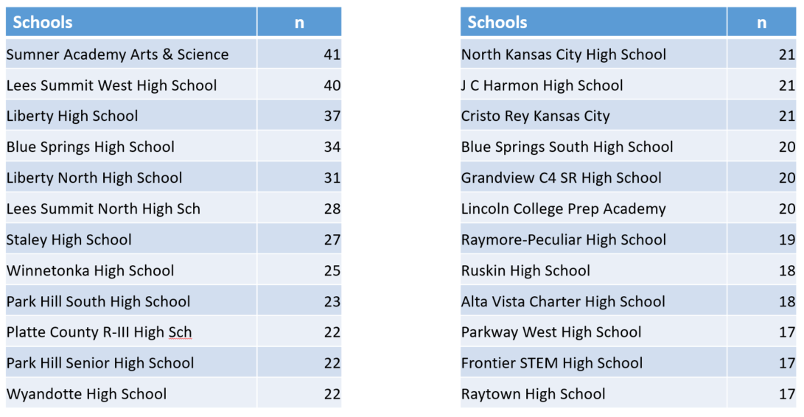
HIGH SCHOOL FEEDERS: FS19 ADMITTED

Slide 13
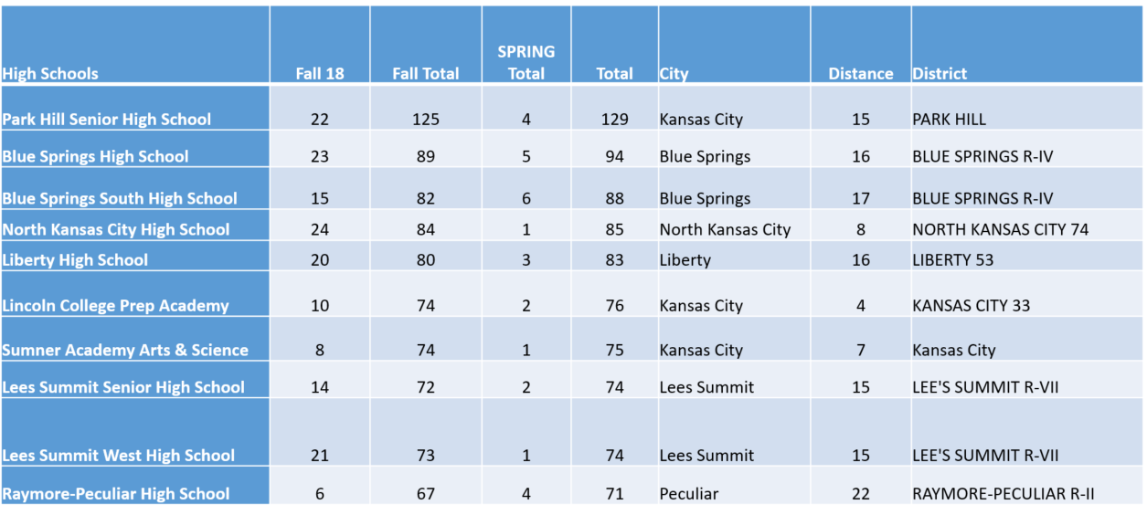
TOP 10 HIGH SCHOOL FEEDERS (2014-2018 ENROLLED)

Slide 14
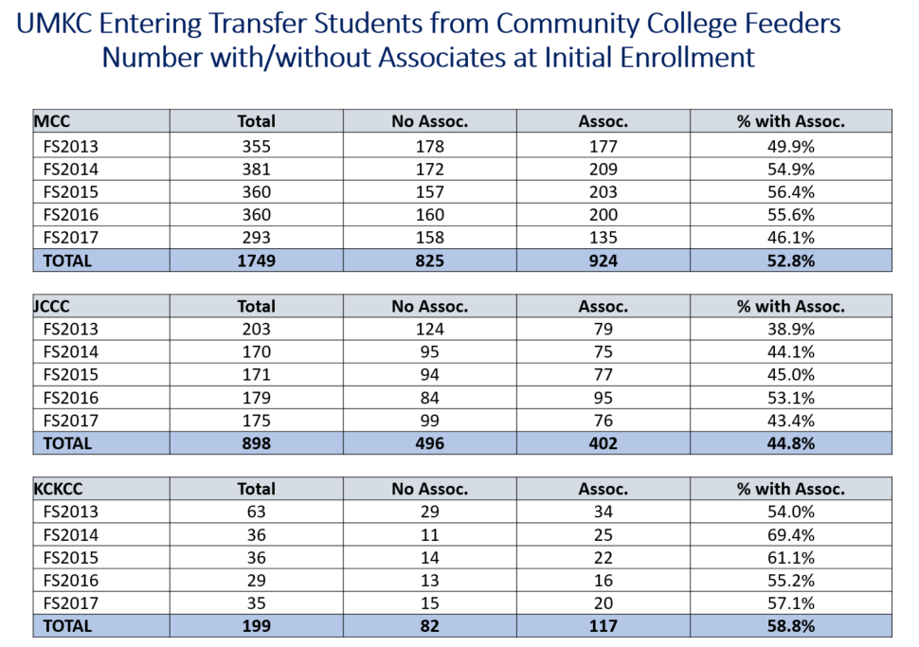

Slide 15
OPPORTUNITIES
Expand recruitment in Kansas.
Expand recruitment in the Heartland states.
Expand recruitment of underrepresented minority students.
Increase the number of high school visits and college fairs attended.
Increase the number of visit days offered by the Welcome Center.
Increase group visit opportunities and “in-school” opportunities for our K-12 partners in KCMO, KCK, Shawnee Mission, private schools, and other partners.
Streamline campus-wide activities with a focus on recruitment to UMKC.

Slide 16
INSTITUTIONAL COMPARISONS
PEER TYPE | AVERAGE # OF RECRUITMENT STAFF | RANGE OF RECRUITMENT STAFF | AVERAGE # OF ADMISSIONS COUNSELORS | RANGE OF ADMISSIONS COUNSELORS
UMKC | 8 |  | 6
Aspirational | 24 | 16 - 41 | 15 | 11 - 20
Operational | 22 | 17 - 28 | 14 | 10 -16
UM System | 22 | 18 - 27 | 13 | 6 - 23
Regional | 20 | 11 - 26 | 9 | 6 - 17

Slide 17
UMKC STRATEGIC PLAN
STRATEGY 2
Grow the University’s undergraduate student body by increasing the funnel (number of applications) of first-time freshman and transfer students.

Slide 18
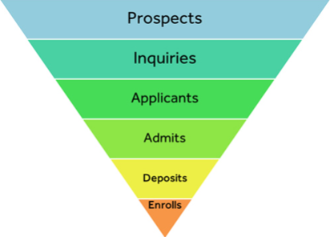
TRADITIONAL RECRUITMENT FUNNEL

Slide 19
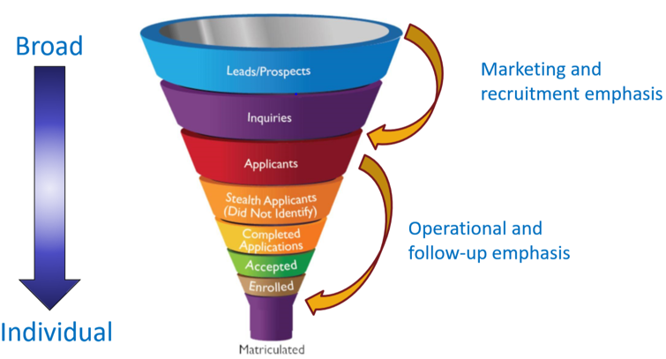
RECRUITMENT FUNNEL
AACRAO Admissions Funnel, May 2018

Slide 20
CURRENT STATUS
Need work in all areas of the funnel.
Name buys: UMKC purchased sophomore names in February 2018, and junior and senior names in October 2018 and December 2018.
There is now a communication plan in place for name buy students (prospects). The goal of that plan is to convert prospects to inquiries.
Transfer student/community college visits streamlined through the Office of Admissions.

Slide 21
CURRENT STATUS
Communication plans under continuous development. New plans for:
Prospects
Sophomore inquiries
Junior inquiries
Senior inquiries
Senior admits (summer melt campaign)

Slide 22
OPPORTUNITIES
Academic unit and departmental communication plans.
Communication plans for targeted groups (e.g. underrepresented minorities, first-generation, etc.).
Engage faculty in student recruitment.
Admissions counselor territory management to increase personalized and individualized attention for students.
Additional visit opportunities to increase the number of students we have visiting campus.
The campus visit is the #1 influence on the college decision-making process.
Transfer student communication campaigns and visit opportunities.

Slide 23
UMKC STRATEGIC PLAN
STRATEGY 3
Increase the yield of students
admitted to UMKC.

Slide 24
CURRENT STATUS
Experience UMKC event
Email and postcard campaign
Summer melt communication campaign
Orientation
Ruffalo Noel Levitz partnership

Slide 25
OPPORTUNITIES
Academic unit and departmental engagement with admitted students.
Improved summer melt campaign.
Admissions counselor territory management to increase personalized and individualized attention for students.
Engage faculty in student recruitment.
Orientation as a recruitment/yield event.
Online orientation as an option.
Marketing for admitted students (e.g yard signs, t-shirts, etc.).
Slate development.
Increased housing opportunities for students.

Slide 26
SLATE DEVELOPMENT
Automate admission decisions in Slate with a 48 hour turn-around for applicants.
Fully implement Student Checklists for better automation and communication.
Implement the ability to process applications in Slate and have decisions moved to PeopleSoft seamlessly.
Admit and process dual high school students in Slate and fully integrate the enrollment process from Slate to PeopleSoft.
Create specialized letters of recommendations and supplemental application materials for both undergraduate and graduate programs.
Develop a robust recruitment dashboard for key Enrollment Management stakeholders, admissions representatives and the Academic Units.
Deploy a better process for automating the management of duplicate records in Slate.
Implement text messaging to provide a streamlined way to connect with prospective students about recruitment events, deadlines, decisions, etc.

Slide 27
UMKC STRATEGIC PLAN
STRATEGY 4
Target enrollment growth in areas of market opportunity that meet regional, national and global workforce needs.

Slide 28
OPPORTUNITIES
Market analysis for new territories for recruiting (e.g. Heartland states).
Analysis of new communication mediums for recruiting high school and transfer students.
Recruitment plan for those programs that have room to grow.
Engage faculty in recruitment initiatives.
Establish partnerships with community partners to increase enrollment of local/regional students and elevate UMKC name recognition.

Slide 29
UMKC RECRUITMENT PRIORITIES
Inquiry and application generation
Yield strategies
Recruitment staff resources
Slate development
Communication development
Finalize SEM plan and develop recruitment plan
Expanded on-campus housing

Slide 30
UM SYSTEM RECRUITMENT PRIORITIES
In December and February, the UM System campuses reviewed vendors to help support and increase enrollment across all four campuses.
UMKC, UMSL and MU have selected Ruffalo Noel Levitz for this strategic partnership.

Slide 31
RUFFALO NOEL LEVITZ

Slide 32
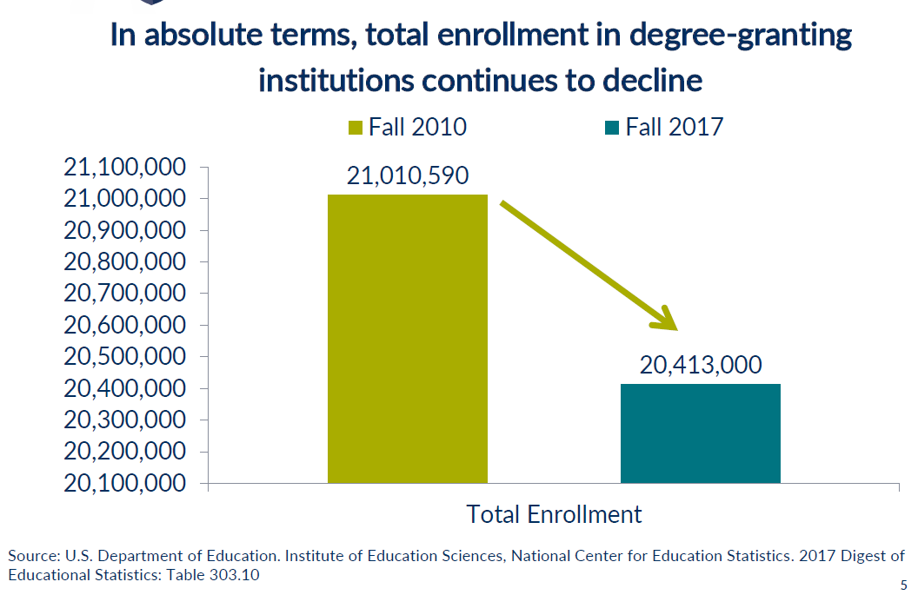

Slide 33
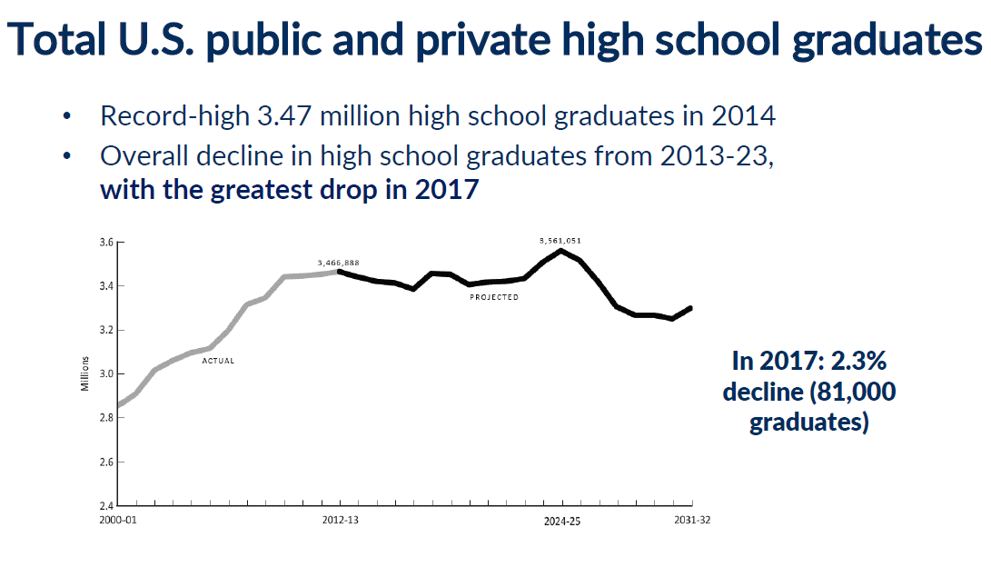

Slide 34
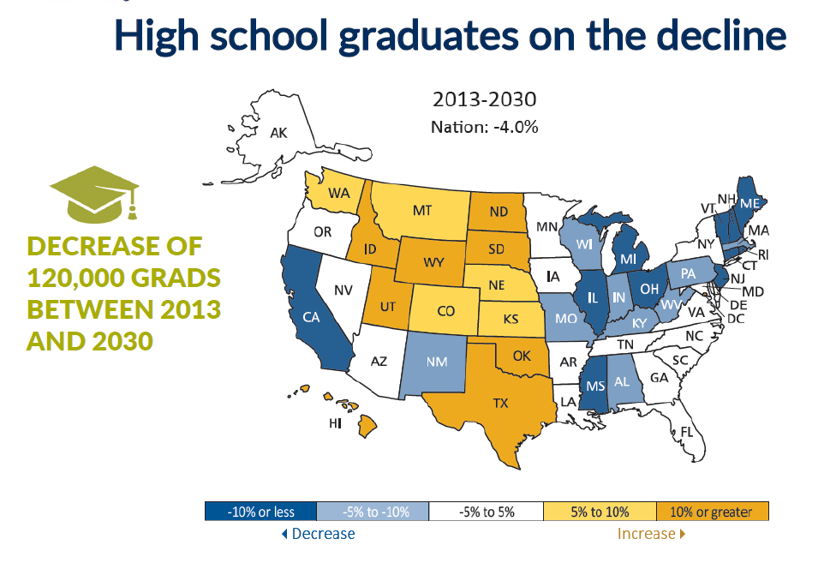

Slide 36
UMKC RECRUITMENT GOALS
Fall 2019 FTC class will grow by 100 students to 1297
Within 3-5 years, grow the FTC class to 1800 students
50% growth in ten years

Slide 37
UMKC YIELD RATES
FTC:
Current yield rate is 35 – 37%
National rate is, on average, 40%
TRN:
Current yield rate is 70%
National yield rate is 65%

Slide 38
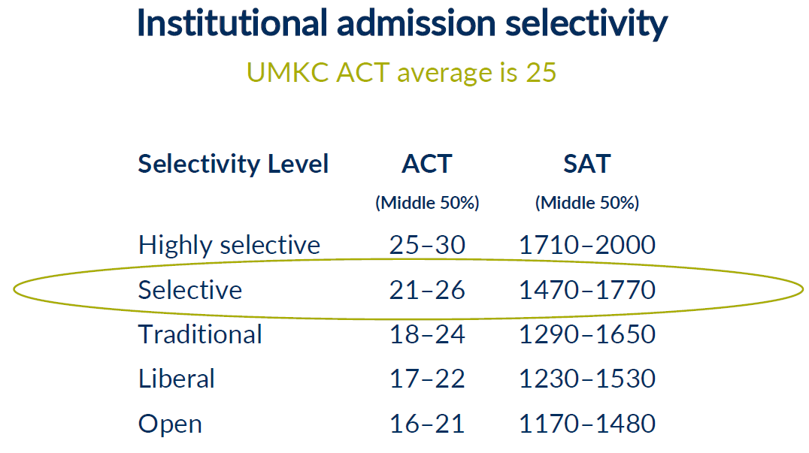

Slide 39
RNL OBSERVATIONS
UMKC has the key elements for success:
People care about the institution, our mission, and our students
Quality product
Strong relationship
Develop strategic and annual enrollment and recruitment plans
Breakdown silos
Tie current and future initiatives to ROI

Slide 40
RNL OBSERVATIONS
Move to a true centralized EM office
All recruitment and admissions staff should be in the office of enrollment management
Plan for benchmarking resources with enrollment goals
We do not tell the UMKC story well – we need to develop strong value proposition statements

Slide 41
RNL OBSERVATIONS
Develop brand platform and recruiting message
UMKC needs to sell what it is has to offer:
Excellence in academics
Personal touch
Outcomes
Affordability and value
Opportunities in KC

Slide 42
RNL ADMISSIONS OBSERVATIONS
Complete territory goals
Prospect, inquiry, application, admit, deposit/confirmation, enrolled, visits, diversity
Track all activities and set engagement goals
Annual meeting with individual units/departments to learn what to sell about their programs
Timing
Good turn around time in inquiries and application (auto admit)
Too slow for non-auto admits
Need to become a data-informed EM office
Work with DSAS to develop profile of successful students by program

Slide 43
RNL YIELD CAMPAIGN FS19& FS20
Increase FS19 enrollment by 100 students
Focus on yield
Yield campaign/survey (class optimizer)
ForecastPLUS applicant to enroll model (4 weeks)
Webcasts, infosessions, Q&A via Conduit platform
Drive additional application activity
Webcasts, infosession, Q&A via Conduit platrofm
Email campaign to purchased records
Increase FS20 enrollment by 100 students
Demand Builder Campaign
Webcasts, infosessions, Q&A via Conduit platform

Slide 44
RNL DEMAND BUILDER
4-6 launches
New name purchase for 100,000 Sr, Jr, So
Outreach emails
925 calling hours
85K direct mail pieces
Custom audience digital targeting
Location based mobile advertising

Slide 45
RNL ADMITTED STUDENT MARKETING
Up to 3 launches
Outreach emails
200 calling hours
Up to 1050 digital print fulfillment postcards
Next day email fulfillment
Custom audience digital targeting
RNL reporting
Conduit platform

Slide 47
RNL Conduit Platform
Promo videos
Student testimonials
Upcoming visits and events
Live chats
Fast facts and availability of documents
Popular links
On-demand video
Academic spotlights
Presentations
Social media

Slide 48
MOVING FORWARD

Slide 49
NEXT FEW MONTHS
Engage with Academic Units to ensure faculty and staff are a part of the SEM Planning Process
Develop Strategic Enrollment Management Goals (SEM) in partnership with AACRAO
Continue to build out UMKC’s SEM Framework with the SEM Council, Recruitment Council and Student Success Model

Slide 50
NEXT FEW MONTHS
Go-live with Summer Orientation registration via Slate
Slate updates and goals for summer 2019 and beyond
Slate training
Communication campaign development
Admissions staff resources
Faculty involvement and training
Recruitment Council subcommittee work

Slide 51
RECRUITMENT COUNCIL STRATEGIC GOALS
Communication and Collaboration Strategies
Focus: Communication between admissions and AUs/departments; Opportunities for collaboration between admissions, AUs, and departments; Review Service Level Agreement; Identify ways to better coordinate what’s happening across campus.
Staff Resources and Training
Focus: Look at resources across campus and identify opportunities for cross-training, shared services, etc.; Identify areas in which recruitment staff needs/wants additional training; Identify professional development opportunities for Recruitment Council; Identify training opportunities for faculty to engage with recruitment.
Build on Strengths
Focus: Look at what we do well and how we can expand or grow those efforts; Identify ways to leverage campus environment in recruiting; Identify possible strategies and issues that effect Recruitment Council and ways in which we can improve; Identify ways to strengthen cross-campus communication between admissions, AUs, and departments.

Slide 52
QUESTIONS & DISCUSSION

